Slide 1
ZONAL GAMES MANAGEMENT FOR ANNA UNIVERSITY SPORTS BOARD
PROJECT GUIDE
DR. S. SWAMYNATHAN
PRESENDED BY,
KARTHIKEYAN S
2019272015
3RD MCA SS

Slide 2
OBJECTIVE
The objective is to build a robust application for managing zonal games by using a set of complex strategies to secure player data and verify player to prevent impersonation and to provide a clean user interface for colleges to enroll players for various events.

Slide 3
Motivation
To encourage sportsmanship and healthy competitions among the colleges involved.
To organize Zonal and Inter-Zonal tournaments in the recognized games and sports, towards selection of University Teams.
To raise the general standards of sports and games towards achievement in Inter-University / National / Inter-National tournaments.

Slide 4
INTRODUCTION
Anna University Sports Board conducts zonal games , it is hard to maintain the student data and keep track of old event records.
It is a necessity to digitalize and store the data on database for easier accessibility of records and to keep the data safe.

Slide 5
Implementation
Language : PHP
IDE : ECLIPSE
Front End : HTML
CSS
JAVASCRIPT
Ajax
Back End : PHP and MYSQL

Slide 6
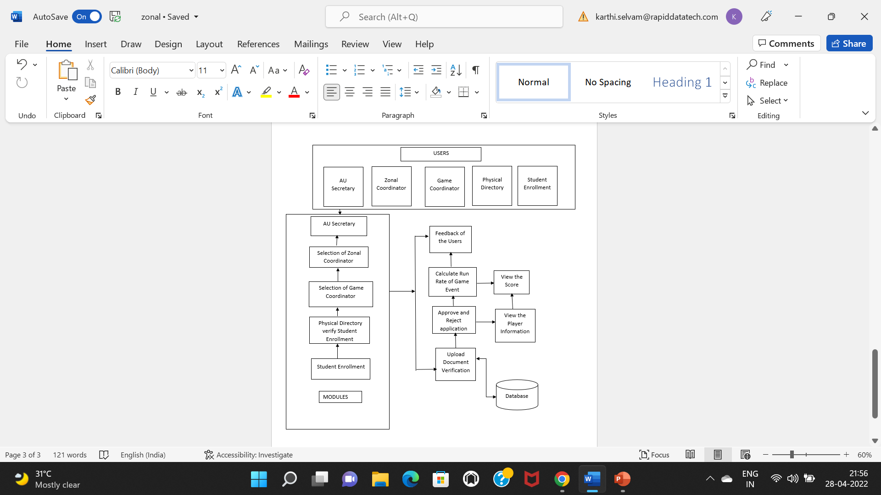
Architecture

Slide 7
Users
AU Secretary.
Zonal Coordinator
Game Coordinator
Physical Directory Participating College
Student Enrolment.

Slide 8
Modules
Au Secretary verify Selection Zonal Coordinator and Player List.
organize the Interzonal Competition.
Zonal Coordinator Register Application (Profile, Education, Certification, Experience, College Name).
Game Coordinator Register Application.(Profile, Education, Certification, Experience, Event game participate Organization).
Physical Directory Student Enrolment Details Student Enrolment (Profile, Education , Participate Event)
Upload document Certification.
Feedback Application(Au Secretary, Zonal Coordinator , Game Coordinator, Physical Directory ).
Calculate Run Rate. Verify Publish Result .

Slide 9
Au Secretary
Get Willingness for Zonal Coordinator apply for the application.
Selecting of 19 Zonal Coordinator.
Provide booklet and Finance to zonal coordinator.
After Completion of Zonal Tournaments Collect Finance Statement ,Result Booklet.
Call for Inter Zonal Activities.
Selecting Inter Zonal Coordinator for 21 games.
Booklet and Finance Support.
Provide Selection Committee List.
Collect Inter Zonal result booklet & Audit Statement.
Submit to the AU Secretary.

Slide 10
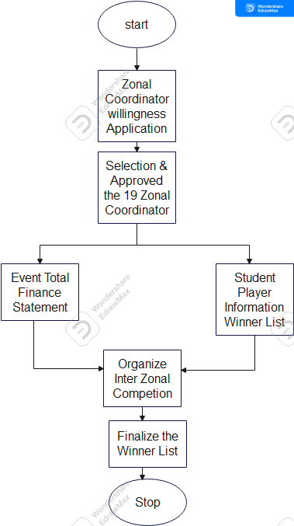
Au Secretary

Slide 11
Zonal Coordinator
Get Willingness for game Coordinator.
Selecting 21 game Coordinator.
Allocating of one Game to One Game Coordinator.
Allocate Finance For each game.
Get Result for each game & booklet for game Coordinator.
Submit Zonal booklet to Secretary.
Feedback to Game Coordinator to Au Secretary.
Submit Audit report

Slide 12
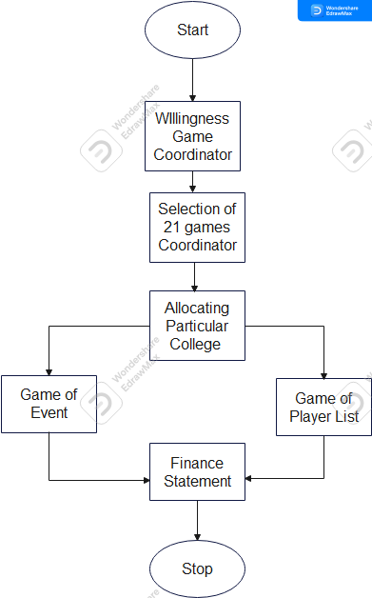
Zonal Coordinator

Slide 13
Game Coordinator
Game Coordinator Collect each Game, call for Participate List.
Collect student details Based on Eligibility Proforma application.
(profile, Education, Event details and College seal ,signature of dean).
Calculate the player Score .
Coordinator tournament and declare result.
Feedback to Game Coordinator to zonal Coordinator.
Submit to zonal Coordinator & Audit report.

Slide 14
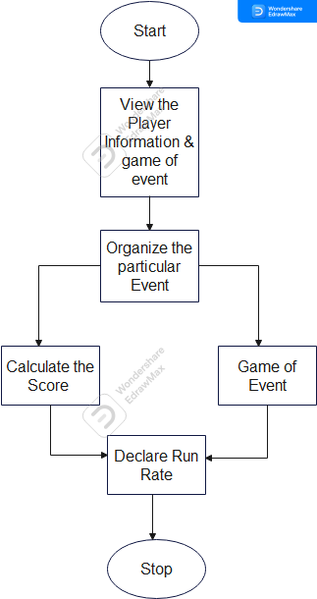
Game Coordinator

Slide 15
Participating College Physical Directory
Upload willingness for a specific games.
Upload student Enrollment details with authentication.
Receive medals and certificate(winner, Runner).
Verify student Details
Feedback to Game coordinator.

Slide 16
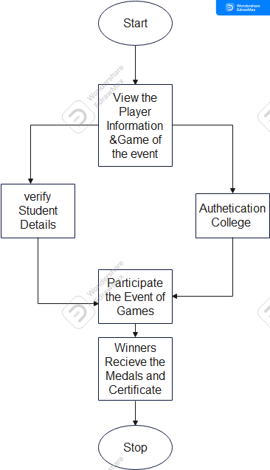
Physical Directory of College

Slide 17
Student Enrollment
Student view the available of Games.
Student Enrollment the details .
Verify and update the details.
Student view our Score of Records.

Slide 18
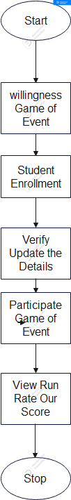
Student Enrolment

Slide 19
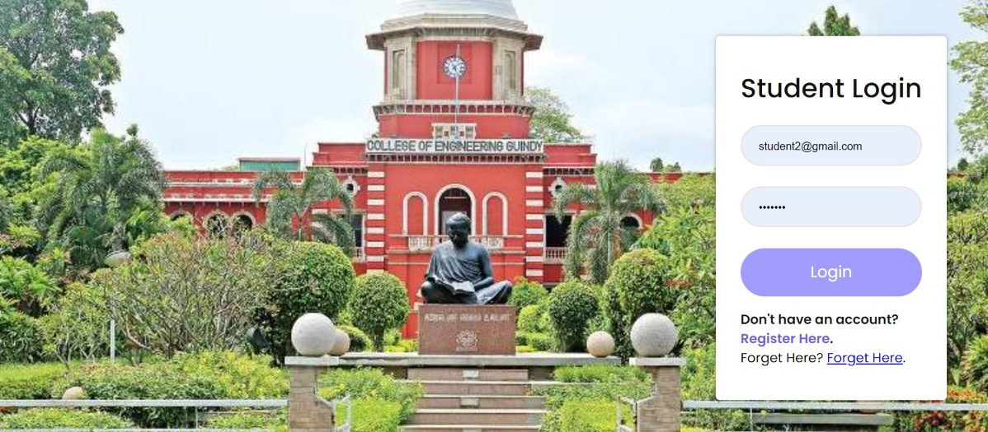
STUDENT LOGIN

Slide 20
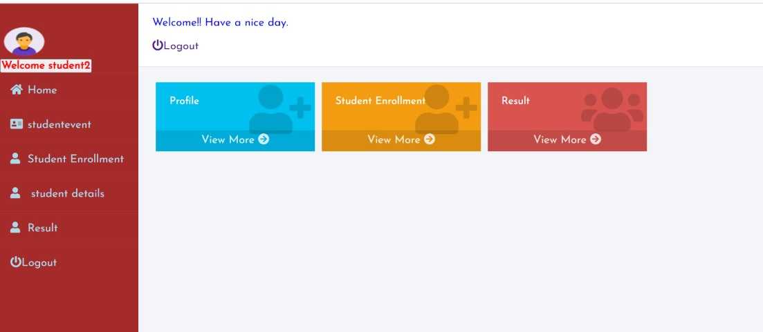
Student Dashboard

Slide 21
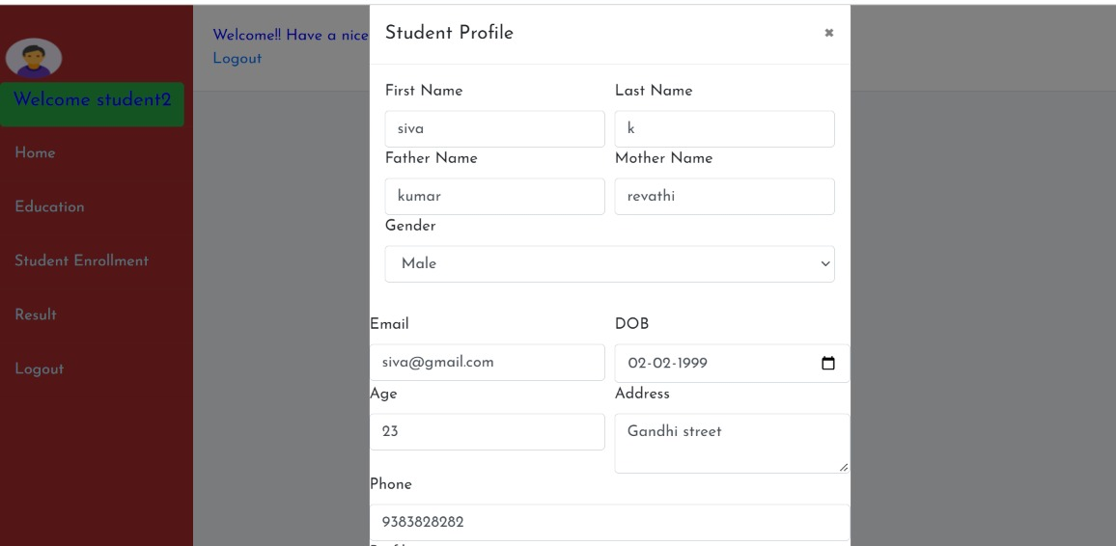
STUDENT ENROLMENT

Slide 22
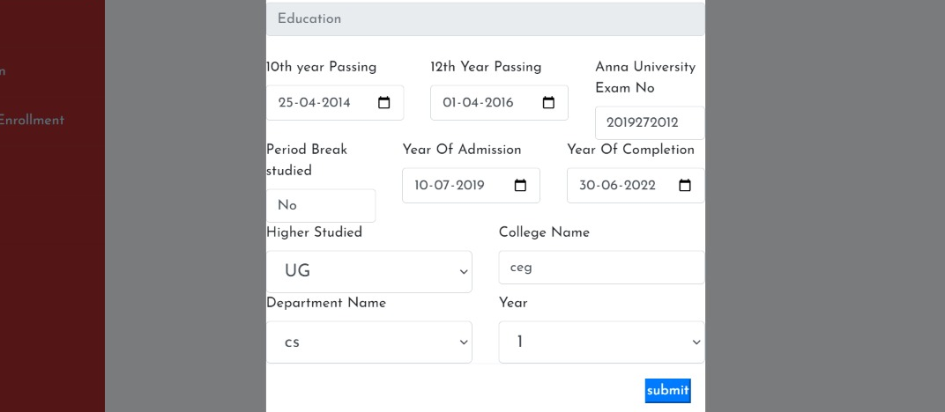
STUDENT EDUCATION DETAILS

Slide 23
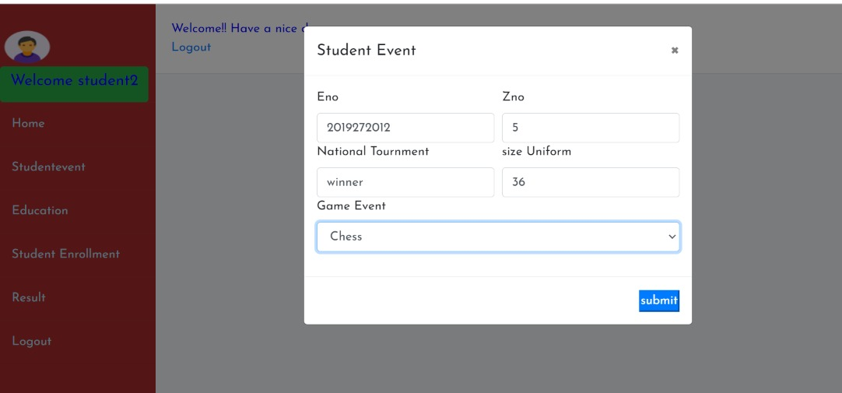
STUDENT EVENT

Slide 24
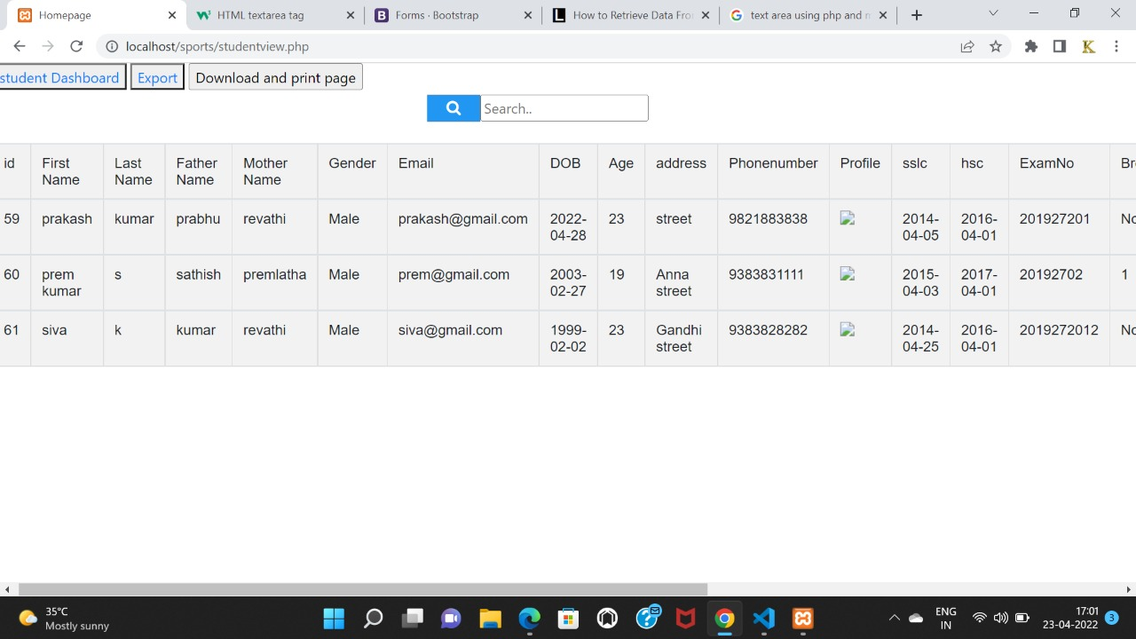
INSERT STUDENT DETAILS

Slide 25
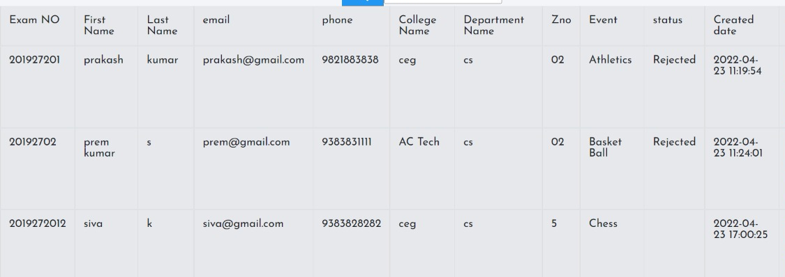
STUDENT EVENT

Slide 26
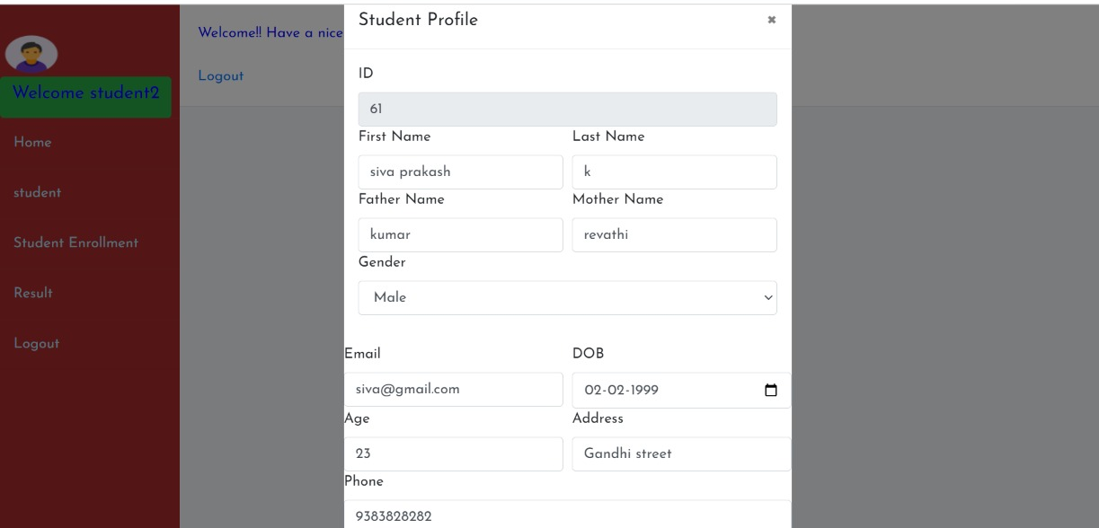
UPDATE DETAILS

Slide 27
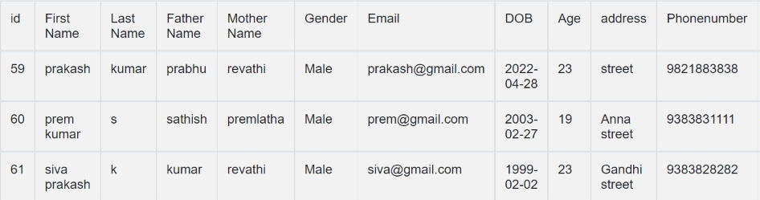
UPDATE DETAILS

Slide 28
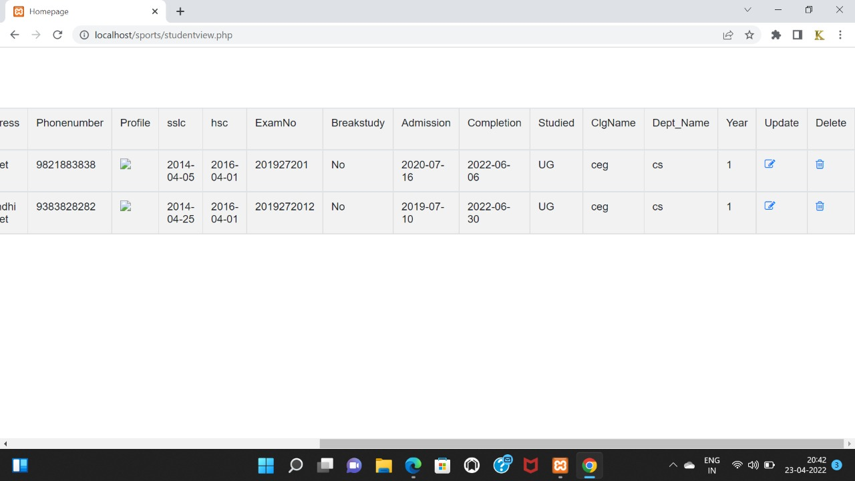
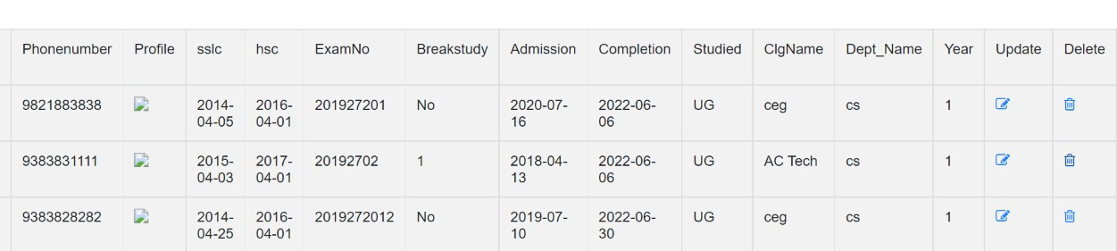
Delete Details

Slide 29
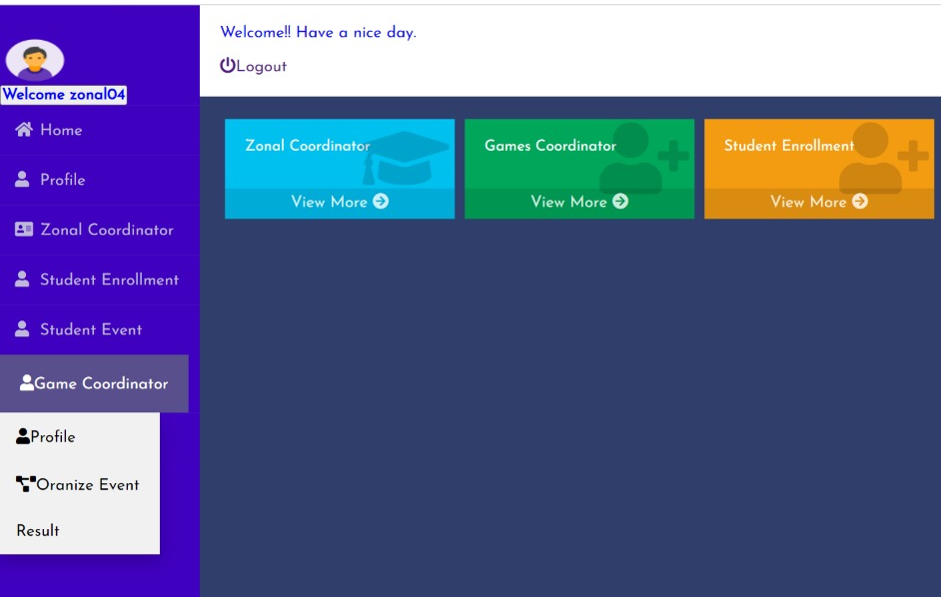
Zonal Coordinator

Slide 30
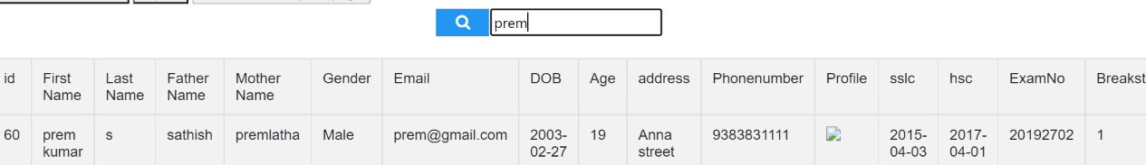
Search Details

Slide 31
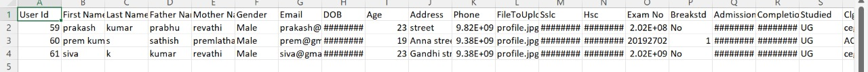
STUDENT EXPORT
Zonal Coordinator download excel file

Slide 32
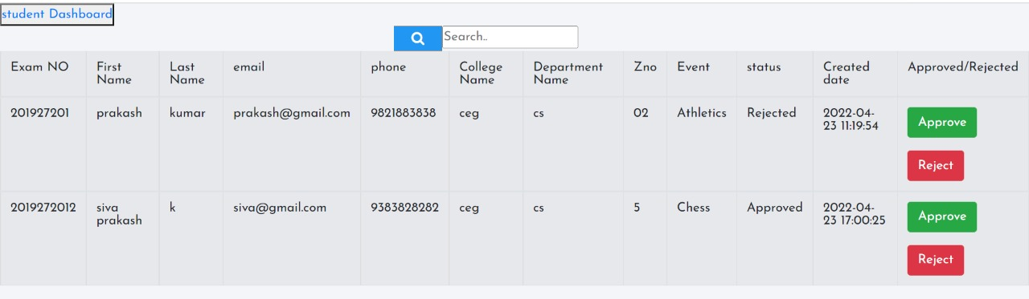
APPROVE AND REJECT
Zonal coordinator verify details approve and reject the details

Slide 33
REFERENCES
https://www.w3schools.com/php/
https://www.w3schools.com/php/php_mysql_select.asp
https://www.w3schools.com/php/php_ajax_php.asp

Slide 34
THANK YOU

